Slide 1
Module 3 HuggingFace and Agentic AI

Slide 2
HuggingFace
Inference Providers
Call models via managed APIs
Ways to access models on HuggingFace
Existing Spaces
Use models through public demos
Own Space (Gradio)
Host your own AI model app on HuggingFace
Run Models Locally
Download and run on your machine

Slide 3
HuggingFace
Inference Providers
Advantages
Disadvantages
Fast setup, no infrastructure needed
Managed scaling and updates
Access to many popular models
Simple API and SDK usage
Suitable for quick experiments
Not all models are supported
Limited model parameter control
Shared infrastructure constraints
Costs increase with usage
Not ideal for strict SLAs or compliance

Slide 4
HuggingFace
Using Existing Spaces
Advantages
Disadvantages
Instant access through web UI
No setup or deployment required
Useful for demos and learning
Shows real model behavior
Often free to use
Not designed as stable APIs
Can break or go offline anytime
Limited control over model and logic
Shared resources cause slowdowns

Slide 5
HuggingFace
Host your Own Space using Gradio/Streamlit
Advantages
Disadvantages
Full control over model and logic
Custom preprocessing and workflows
Interactive UI for users
Supports niche and custom models
No inference provider dependency
You manage performance and limits
Slower on CPU for heavy models
Cold starts can impact latency
Limited scalability by hardware free tier

Slide 6
HuggingFace
Local Inferencing of Models
Disadvantages
Advantages
Full control over hardware and setup
No usage-based API costs
Works offline and with private data
Supports any model or customization
Predictable performance and latency
Requires setup and maintenance
Hardware costs and capacity planning
No automatic scaling
You handle updates and security
Higher operational effort

Slide 7
Agentic AI
Types
No-Code/Low-Code | These let you build agents with minimal programming experience. Eg: Flowise, n8n, etc
Code-First Frameworks | Better suited if you want flexibility and control, but still relatively approachable for beginners with basic programming skills. Eg : LangChain, CrewAI, AutoGen
Platform-Level Kits | These are full SDKs or kits designed for production and complete agent capability. Eg: Google Agent Development Kit, OpenHands Software Agent SDK

Slide 8
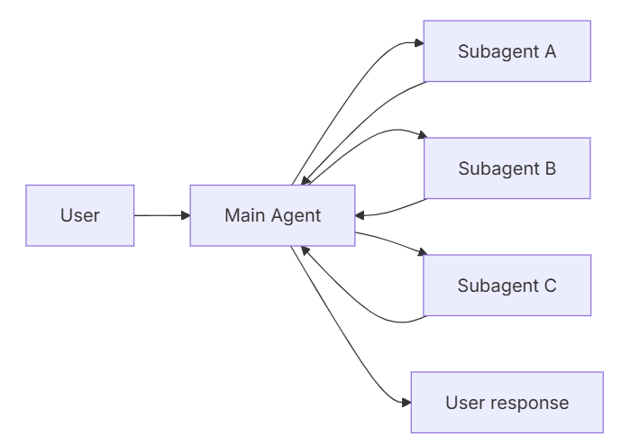
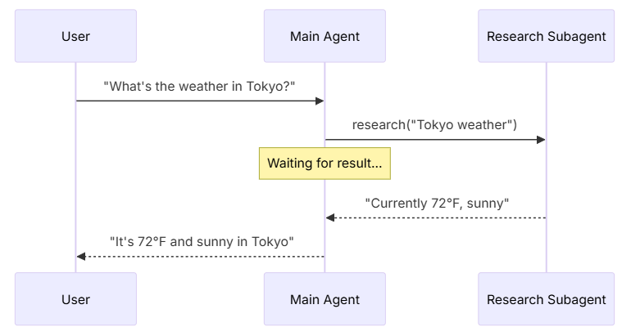
Subagents

Slide 9
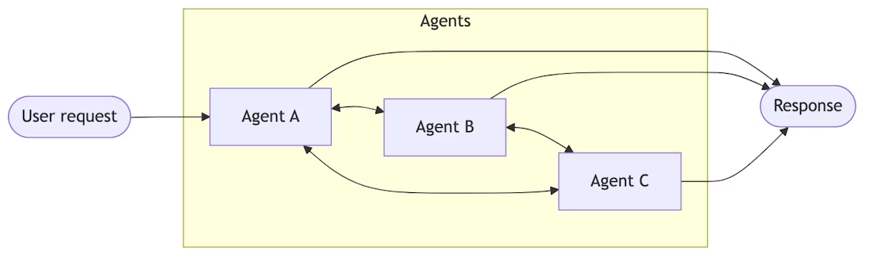
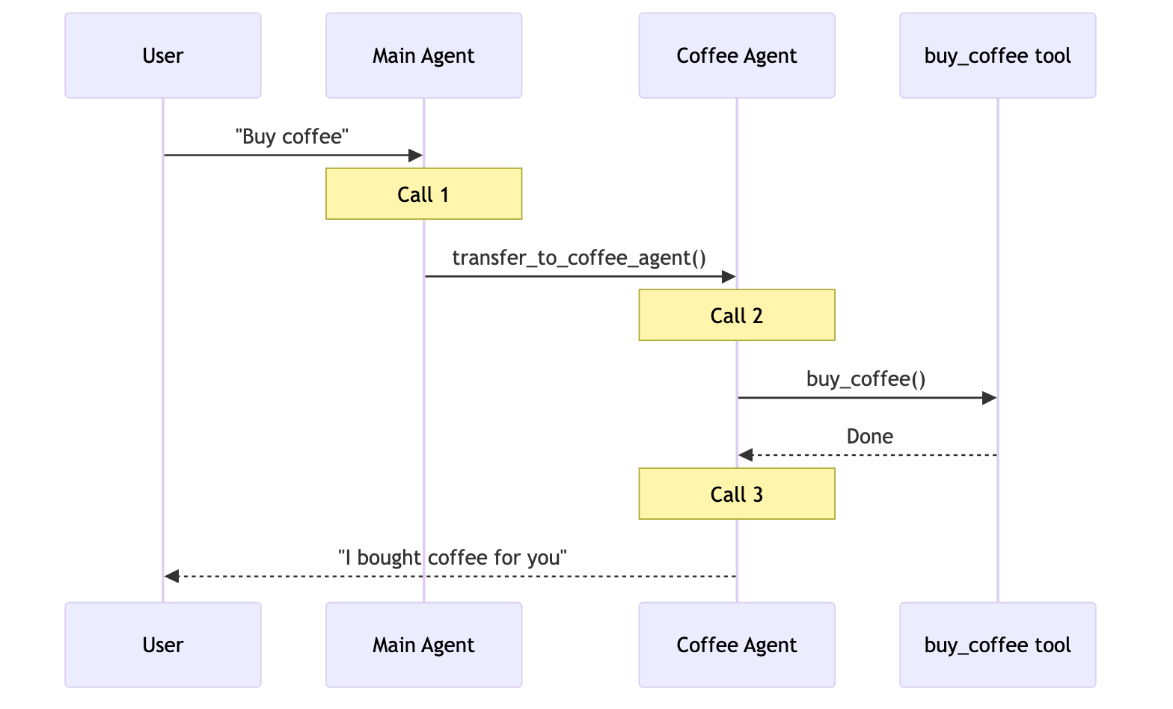
Handoffs

Slide 10
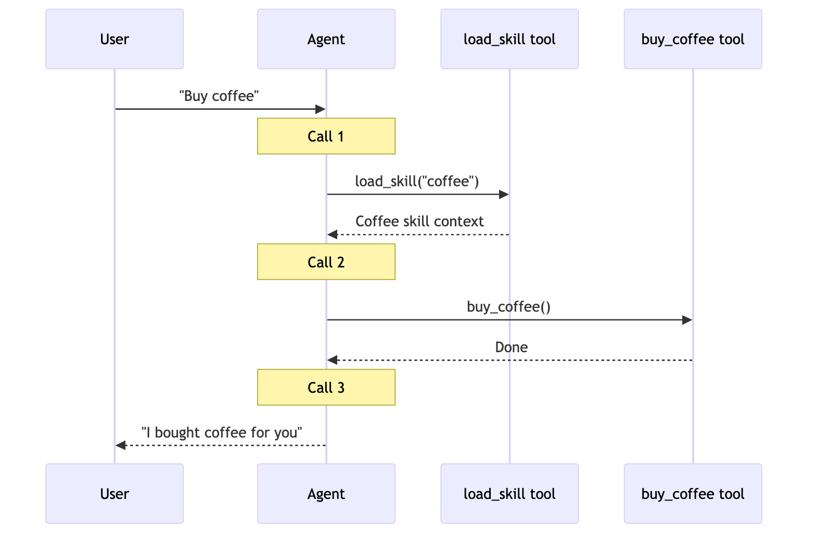
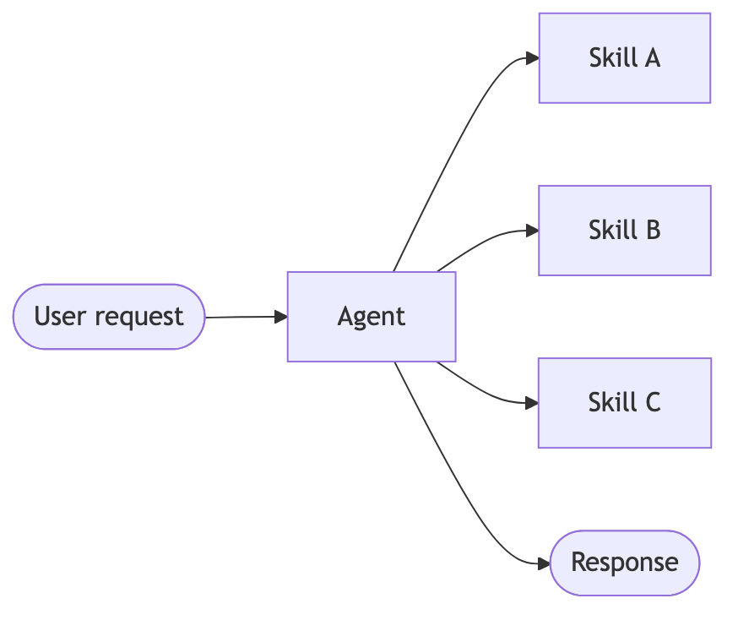
Skills

Slide 11
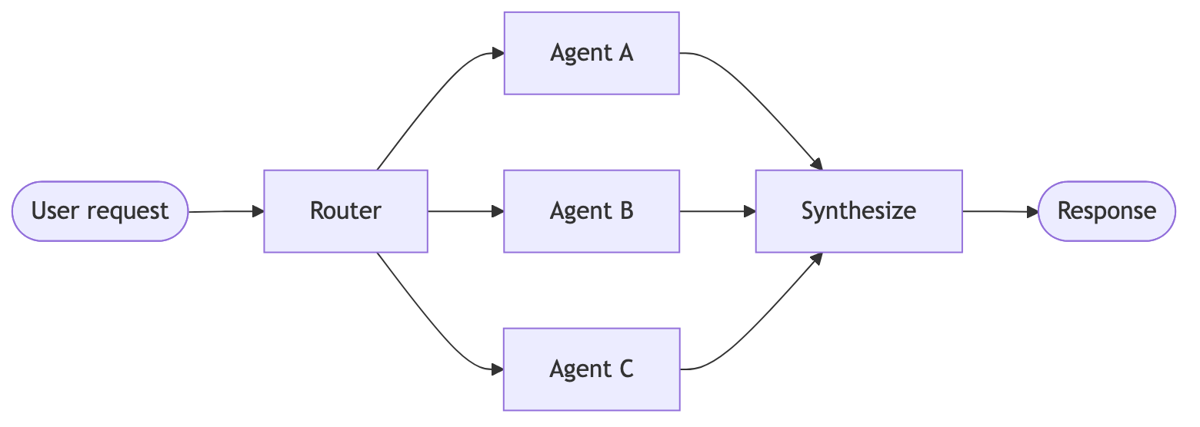
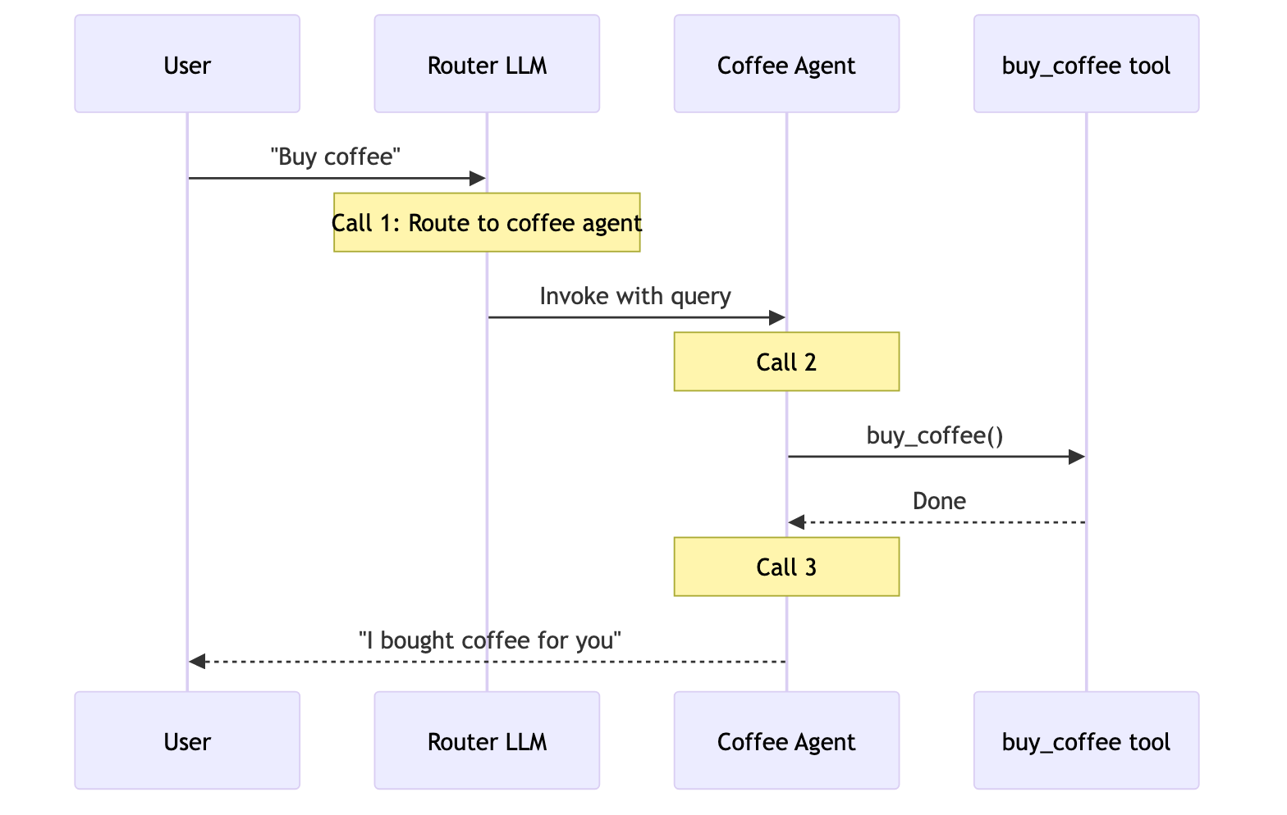
Router

